Slide 1
Container Security Current Pricing
Trend Vision One - Container Security Pricing
Available Oct-01:
per Kubernetes node or Amazon ECS instance:
$1,155 / yr
1,100 credits / yr
per serverless container pod or task:
$115.50 / yr
110 credits / yr

Slide 2
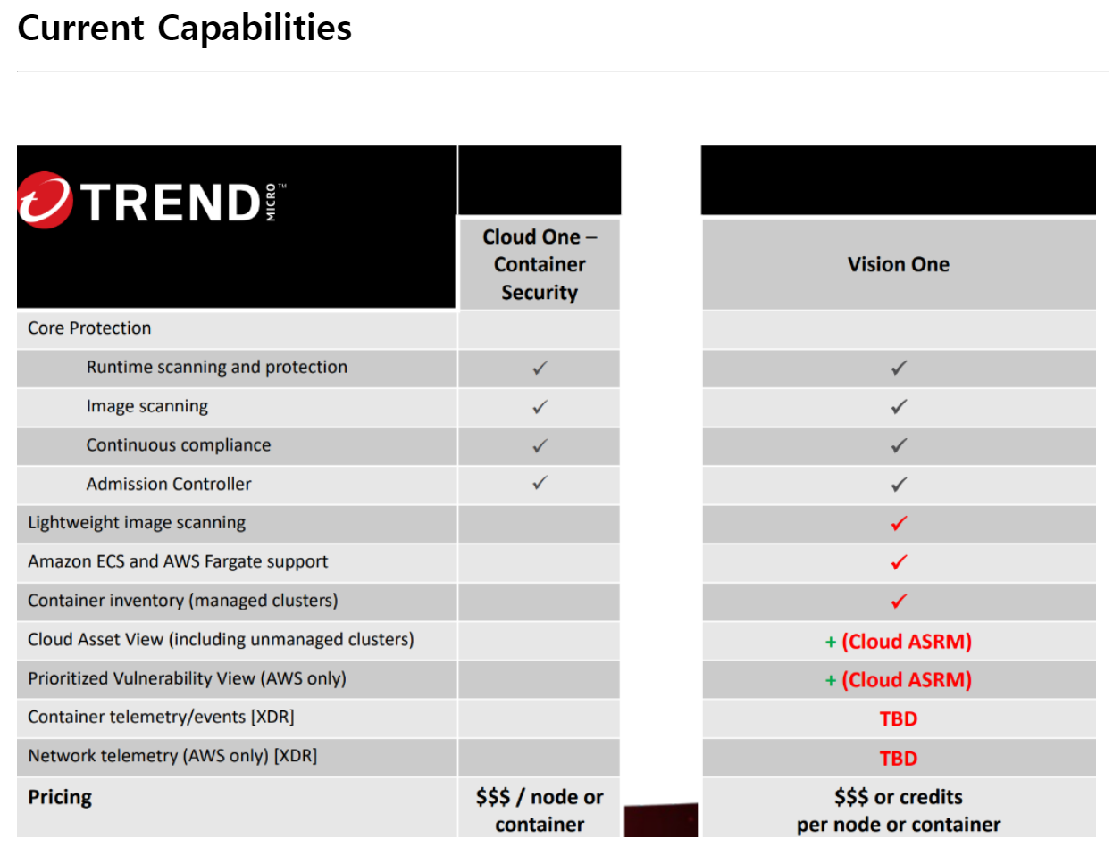

Slide 3
